Slide 1
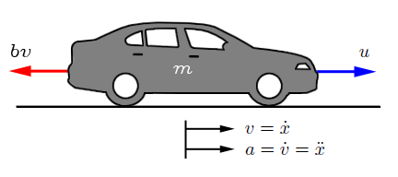

DEVELOP A VEHICLE DYNAMICS MODEL
By applying newton’s second law of motion:
$$m\ddot{x}=u−bv$$
Getting the transfer function as before:
$$mSV(s)=U(s)−bV(s)$$
Getting the output/input
$$\left(mS+b\right)V\left(s\right)=U(s)$$
Therefore
$$V\left(s\right)/U(s)=1/\left(mS+b\right)$$
http://ctms.engin.umich.edu/CTMS/index.php?example=CruiseControl&section=ControlPID

Slide 2
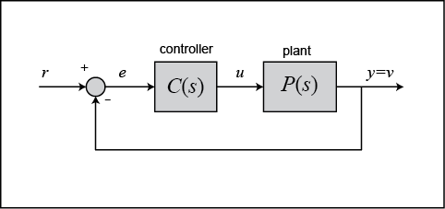

DEVELOP A VEHICLE DYNAMICS MODEL: PID CONTROLLER

Slide 3
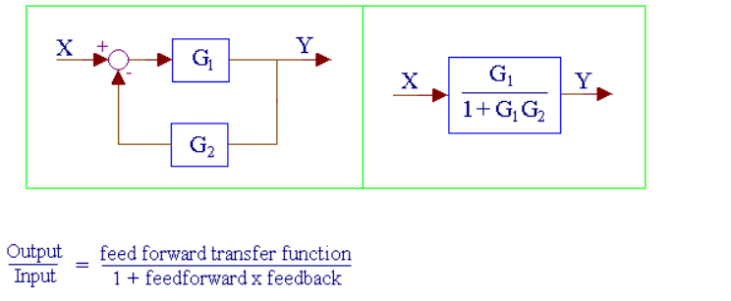
DEVELOP A VEHICLE DYNAMICS MODEL: MODEL REDUCTION
http://www.msubbu.in/sp/ctrl/BD-Rules.htm

